Slide 1
Predict CTR of an Email Campaign.

Slide 2
Problem Statement
To predict a CTR that "Click through rate" on email campaign. Most organizations today rely on email campaigns for effective communication with users. While ultimate goal of email campaigns is to maximize the Click Through Rate (CTR).
CTR can be calculated as CTR = No. of users who clicked on at least one of the CTA / No. of emails delivered.
Our problem statement is to build a smart system to predict the CTR for email campaigns and therefore identify the critical factors that will help the marketing team to maximize the CTR.

Slide 3
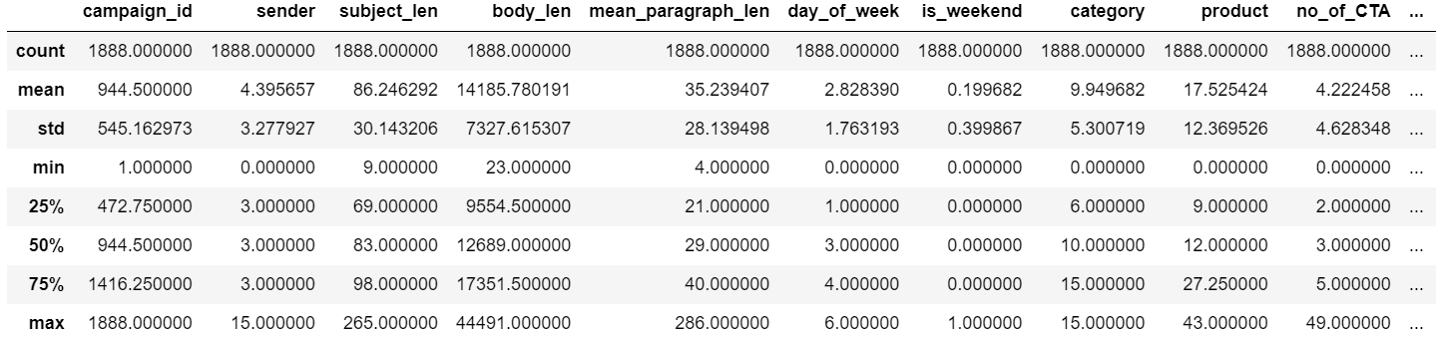
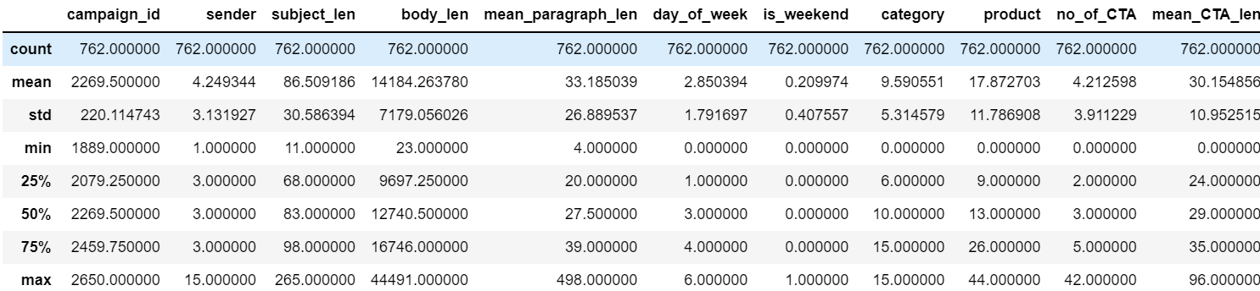
Statistics- Train-Test Distribution
Train and test data have quite same numeric distribution of mean, max and min value.
Both the train and test variable data have a substantial standard deviation.
Thus we can assume both train and test dataset have same distribution.

Slide 4
Missing values
There are no null values in data set.
We can proceed with current dataset.
Target Feature
The value of skewness is positive
It can be interpreted as distribution is right tail is longer
The mass of the distribution is concentrated on the left of the figure

Slide 5
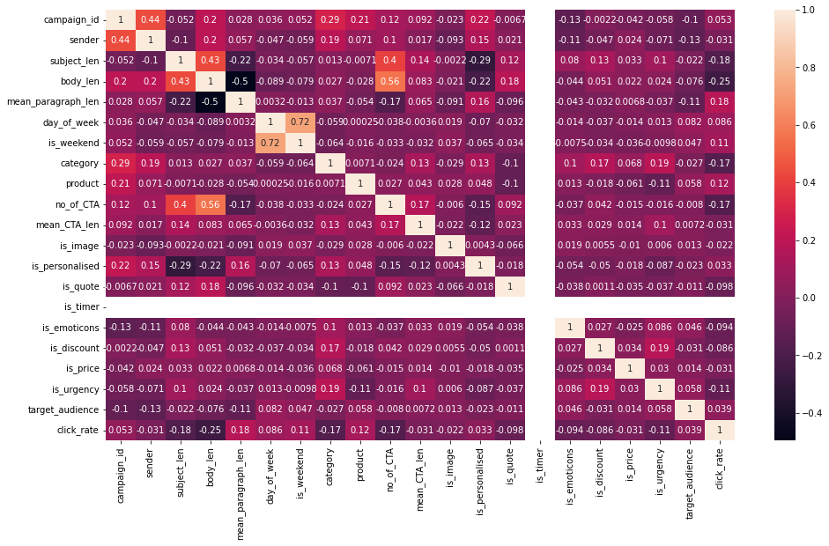
Feature Correlation

Slide 6
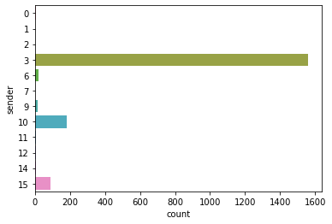
Exploratory Data Analysis-: sender
Sender of an e-mail. It has 12 unique values.
category 3 is having maximum value while other categories having very less value.

Slide 7
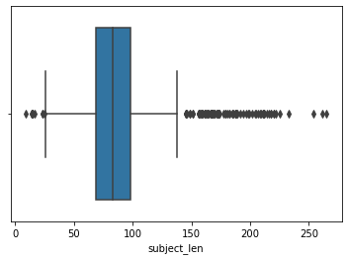
Exploratory Data Analysis-: subject_len
Number of character in subject lies between 25 words to 140 words approximately.
While some of email campaigns have Number of character in subject above 150 and up to 250.

Slide 8
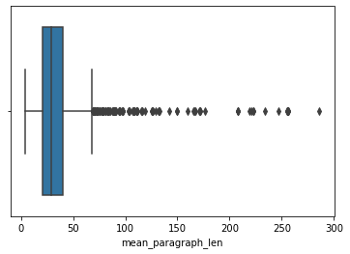
Exploratory Data Analysis-: mean_paragraph_len
Number of character in body lies between up to 70 approximately.
While some of email campaigns have Number of character in body are above 70 and upto 300.

Slide 9
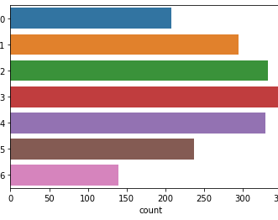
Exploratory Data Analysis-: day_of_week
It is categorical feature on which day email is sent.
Count of email sent increasing from day 0 to day 3 gradually.
While it is then decreasing from day 3 to day 6.

Slide 10
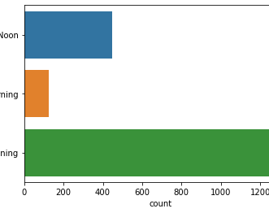
Exploratory Data Analysis-: times_of_day
It is categorical feature on which time email is sent.
Most of the email sent in evening time followed by noon.

Slide 11
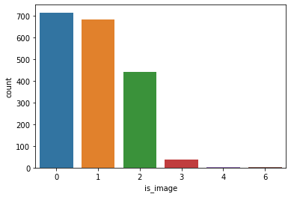
Exploratory Data Analysis-: is_image
Most of emails having zero images.
But emails having images are also significant value , hence it can be useful feature.

Slide 12
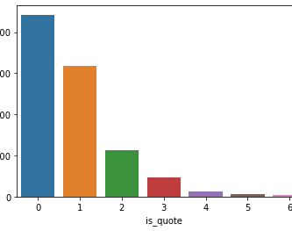
Exploratory Data Analysis-: is_quote
Most of emails having zero quote.
But emails having quote are also significant value , hence it can be useful feature.

Slide 13
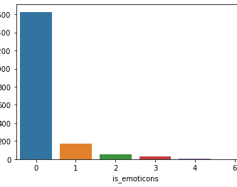
Exploratory Data Analysis-: is_emoticons
Here we can see most of almost 1600 emails have 0 emoticons.
So we can drop this feature as it is not providing more information.

Slide 14
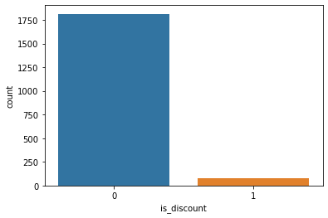
Exploratory Data Analysis-: is_discount
Here we can see most of almost 1750 emails have 0 discount flag.
So we can drop this feature as it is not providing more information.

Slide 15
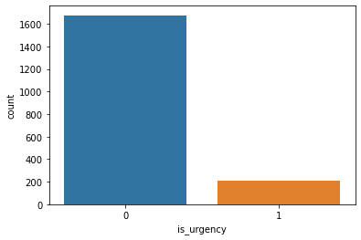
Exploratory Data Analysis-: is_urgency
Here we can see most of almost 1600 emails have 0 is_urgency flag.
So we can drop this feature as it is not providing more information.

Slide 16
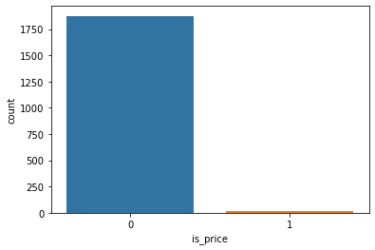
Exploratory Data Analysis-: is_price
Here we can see most of almost 1750 emails have 0 is_price flag.
So we can drop this feature as it is not providing more information.

Slide 17
Data Pre-processing
From above data analysis we came to know that some features are dominating in train dataset.
Also if we can check statistically those features having very correlation with target features.
Those features can we dropped from train and test data set.
Also following categorical features are encoded as target encoding.
Product
Category
target_audience

Slide 18
Model Training
Random forest regressor is used for training model.
Hyperparameter tuning done using Gridsearchcv.
Hyperparameters tuned-:
'max_depth’
'n_estimators’
Final R2 score of test dataset is 0.45

